Slide 1
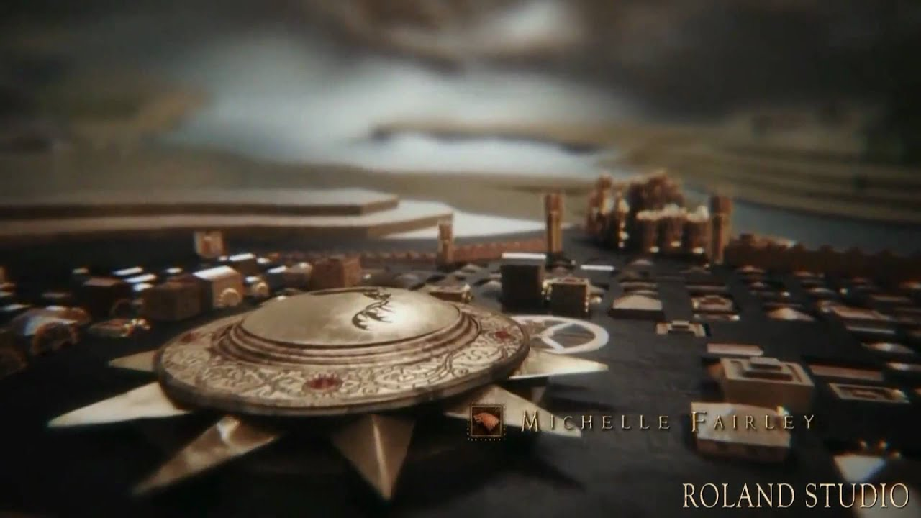
Agent Based Cities
Jacob Wynd
Scott Melero
Notes:
Jacob

Slide 2
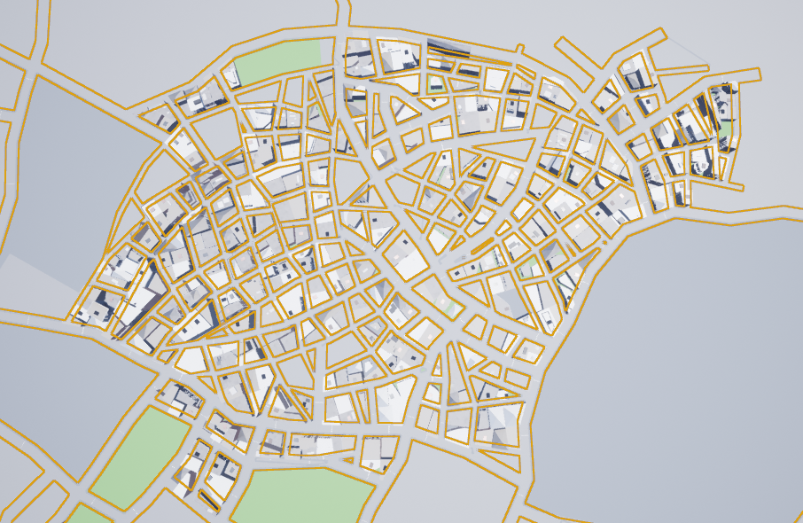
The Plan
We originally wanted to create agent based cities using a process similar to this. However the provided code did not work on current versions of Unreal and we lacked time to replicate it.
Notes:
We explored a few algorithmic techniques such as L-systems and wave function collapse, but finding up to date guides was our biggest challenge

Slide 3

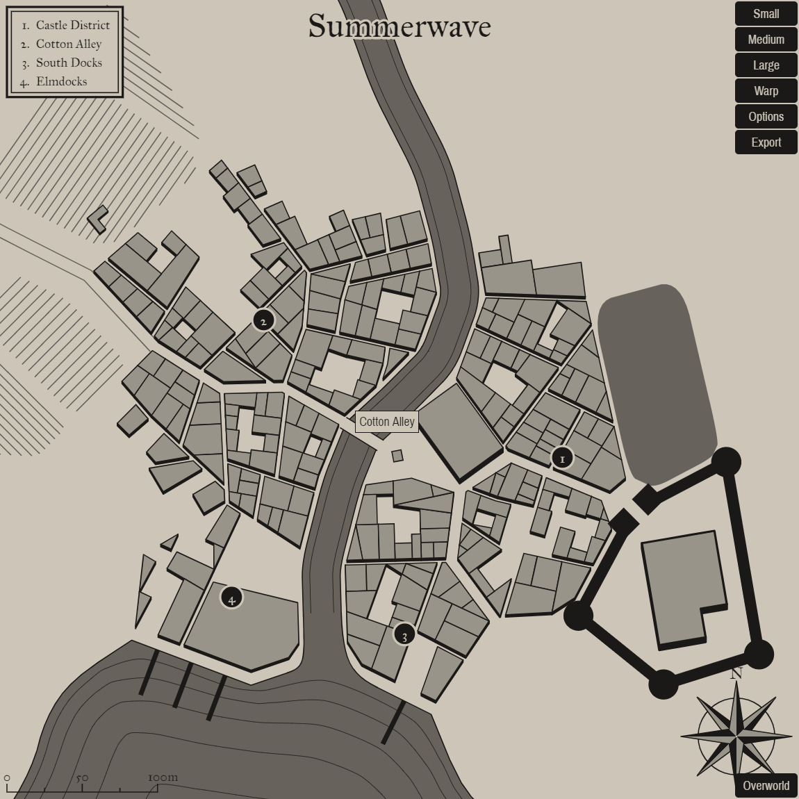
Voronoi
Map made using Voronoi diagrams
We also briefly considered using voronoi diagrams to model roads and then place buildings in between, unfortunately the Unreal engine does not make a process like this easy...
Notes:
Jacob

Slide 4
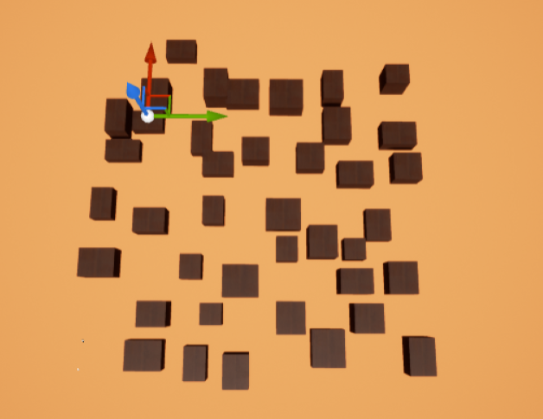
Early Versions
We eventually managed to get assets to spawn at random in a volume without intersecting. Unfortunately we could not solve the problems of roads or placing different models in the scope of this project.
Notes:
Jacob

Slide 5
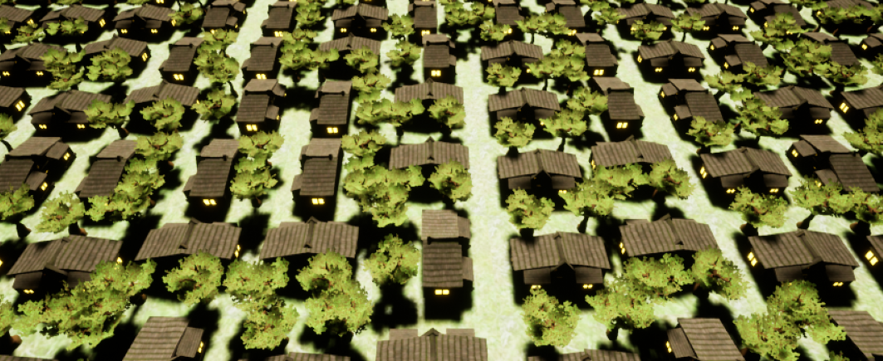
Strategy
We eventually settled on a framework in which 3d tiles were placed on a plane in unreal, and rotated at random. Roads are drawn somewhat randomly on the intersections between tiles.
Example with one tile
Notes:
Scott
We have a collection of tiles with prefabs on them that are used to build the city
These tiles are chosen at random from an array of these collections
The roads are also placed on tiles and drawn on top of the city

Slide 6
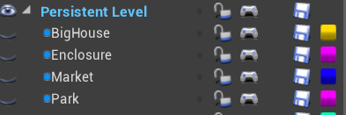
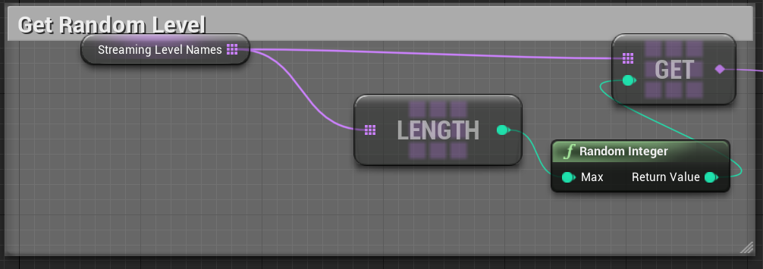
How it Works
An empty persistent level is created and each tile is a child of that level.
A random level is picked from the list of levels and placed into the persistent level at runtime.
Notes:
Scott
Define a series of levels.
Each level contains a prefab set up assets that are placed on a 20x20 tile
The blueprints will loop through each point on the grid select a prefab tile to place on it
The same thing happens for roads.

Slide 7
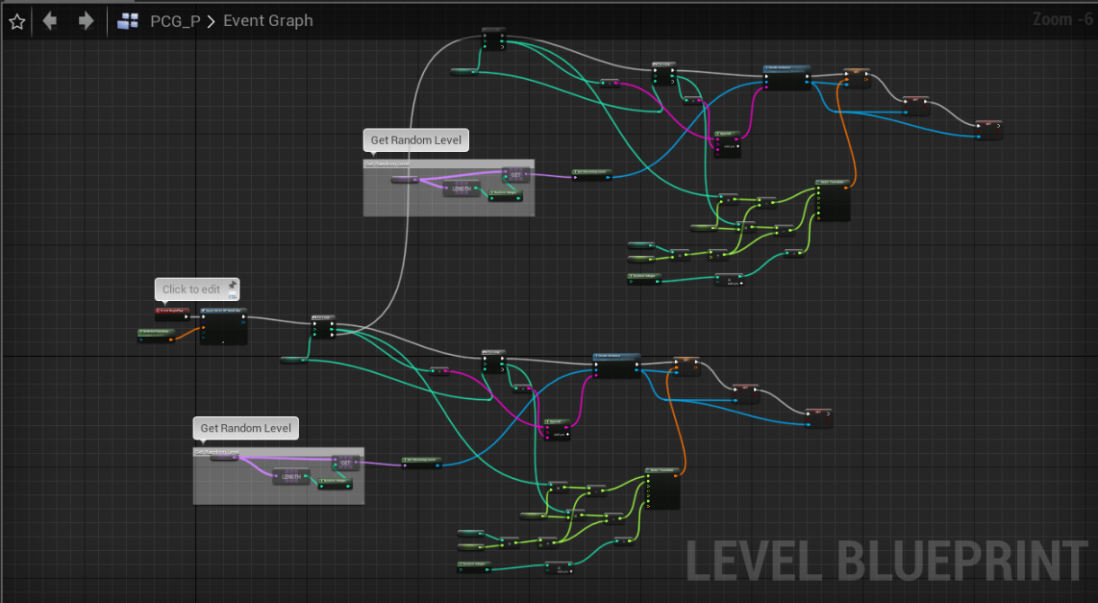
Blueprints
Don’t you all just love them?
Notes:
Problems
Many of the tutorials we found were made using older versions of the engine
Finding the 4.23 equivalent of older nodes was a challenge.
Visual studio compiling problems

Slide 8
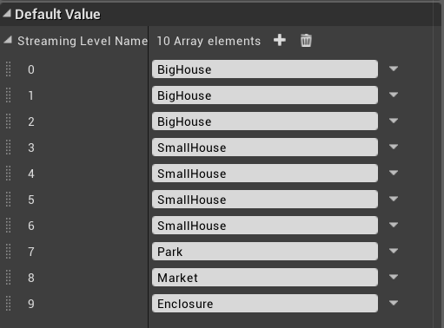
Finishing touches
The frequency at which tiles appear can be modified easily by changing how often they appear in the list of levels.
Notes:
Jacob

Slide 9
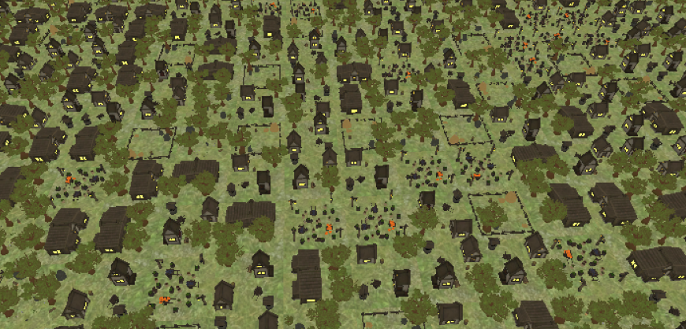
Without Roads
Putting these steps together, with only five hand authored tiles, we can get a large town, for the moment without roads.
Notes:
Jacob

Slide 10
Demo
Notes:
Both Talk, Jacob Runs it

Slide 11
Next Steps
Roads and tiles look at their neighbors to make decisions in context rather than at random.
Terrain extends into the city.
Building interiors
NPCs
Destructible
Player’s can enter and explore
DM authored content
Many many many more tiles
Exportable maps

Slide 12
Resources
https://www.youtube.com/watch?v=mI7eYXMJ5eI
https://coderespawn.github.io/dungeon-architect-user-guide-ue4/stage/html/user_guide_2.7.html
https://martindevans.me/game-development/2015/12/11/Procedural-Generation-For-Dummies/
https://www.youtube.com/watch?v=gClWe2skVN0
Noise Generator
Procedural terrain generation
Demo Project
http://www.procjam.com/tutorials/wfc/
Basic L-systems in UE4
Tile based generation

